Slide 1
Intrusion Detection/Prevention Systems

Slide 2
Objectives and Deliverable
Understand the concept of IDS/IPS and the two major categorizations: by features/models, and by location. Understand the pros and cons of each approach
Be able to write a snort rule when given the signature and other configuration info
Understand the difference between exploits and vulnerabilities

Slide 3
Definitions
Intrusion
  A set of actions aimed to compromise the security goals, namely
    Integrity, confidentiality, or availability, of a computing and networking resource
Intrusion detection
  The process of identifying and responding to intrusion activities
Intrusion prevention
  Extension of ID with exercises of access control to protect computers from exploitation

Slide 4
Elements of Intrusion Detection
Primary assumptions:
  System activities are observable
  Normal and intrusive activities have distinct evidence
Components of intrusion detection systems:
  From an algorithmic perspective:
    Features - capture intrusion evidences
    Models - piece evidences together
  From a system architecture perspective:
    Various components: audit data processor, knowledge base, decision engine, alarm generation and responses

Slide 5

Components of Intrusion Detection System
Audit Records
system activities are observable
Audit Data Preprocessor
Activity Data
Detection
Models
normal and intrusive activities have distinct evidence
Detection Engine
Alarms
Action/Report
Decision
Table
Decision Engine

Slide 6
Intrusion Detection Approaches
Modeling
  Features: evidences extracted from audit data
  Analysis approach: piecing the evidences together
    Misuse detection (a.k.a. signature-based)
    Anomaly detection (a.k.a. statistical-based)
Deployment: Network-based or Host-based
  Network based: monitor network traffic
  Host based: monitor computer processes
Notes:
Need “both” on all these.

Slide 7
Misuse Detection
pattern matching
Intrusion Patterns:
    Sequences of system calls, patterns of network traffic, etc.
intrusion
activities
Example: if (traffic contains “x90+de[^\r\n]{30}”) then “attack detected”
Problems?
Can’t detect new attacks

Slide 8
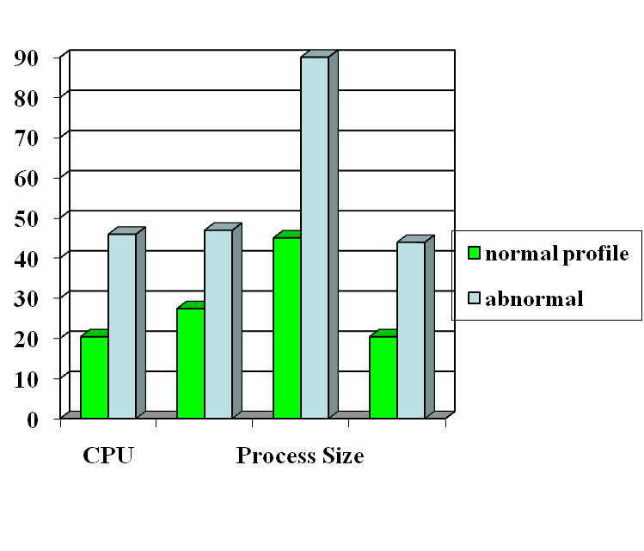

Anomaly Detection
probable intrusion
activity measures
Define a profile describing “normal” behavior, then detects deviations.
Any problem ?
Relatively high false positive rates
Anomalies can just be new normal activities.
Anomalies caused by other element faults
  E.g., router failure or misconfiguration, P2P misconfig
Which method will detect DDoS SYN flooding ?
Notes:
The two axis not shown are IO and page fault.

Slide 9


Host-Based IDSs
Use OS auditing and monitoring mechanisms to find applications taken over by attacker
  Log all relevant system events (e.g., file/device accesses)
  Monitor shell commands and system calls executed by user applications and system programs
    Pay a price in performance if every system call is filtered
Problems:
  User dependent: install/update IDS on all user machines!
  If attacker takes over machine, can tamper with IDS binaries and modify audit logs
  Only local view of the attack
Notes:
BSM: Basic Security Module

Slide 10
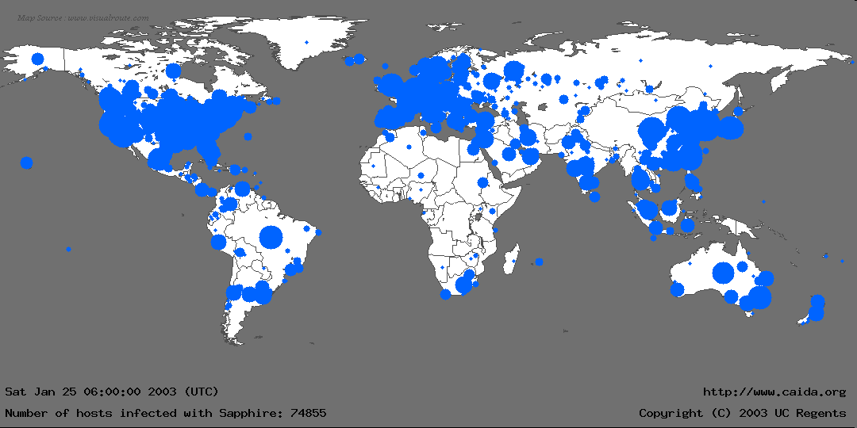
The Spread of Sapphire/Slammer Worms
Notes:
In the first 30 minutes of Sapphire’s spread, we recorded nearly 75,000 unique infections. As we will detail later, most of these infections actually occurred within 10 minutes.
This graphic is more for effect rather than technical detail: We couldn’t determine a detailed location for all infections, and the diameter of each circle is proportional to the lg() of the number of infections, underrepresenting larger infections. Nevertheless, it gives a good feel for where Sapphire spread.
We monitored the spread using several “Network Telescopes”, address ranges where we had sampled or complete packet traces at single sources. We also used the D-shield distributed intrusion detection system to determine IPs of infected machines, but we couldn’t use this data for calculating the scanning rate.

Slide 11


Network Based IDSs
Internet
Gateway routers
Our network
Host based
detection
At the early stage of the worm, only limited worm samples.
Host based sensors can only cover limited IP space, which has scalability issues. Thus they might not be able to detect the worm in its early stage.

Slide 12


Network IDSs
Deploying sensors at strategic locations
  For example, Packet sniffing via tcpdump at routers
Inspecting network traffic
  Watch for violations of protocols and unusual connection patterns
  Look into the packet payload for malicious code
Limitations
  Cannot execute the payload or do any code analysis !
  Even DPI gives limited application-level semantic information
  Record and process huge amount of traffic
  May be easily defeated by encryption, but can be mitigated with encryption only at the gateway/proxy
Notes:
Problems: mainly accuracy

Slide 13
Host-based vs. Network-based IDS
Give an attack that can only be detected by host-based IDS but not network-based IDS
Sample qn:
  SQL injection attack
Can you give an example only be detected by network-based IDS but not host-based IDS ?

Slide 14
Key Metrics of IDS/IPS
Algorithm
  Alarm: A; Intrusion: I
  Detection (true alarm) rate: P(A|I)
    False negative rate P(¬A|I)
  False alarm (aka, false positive) rate: P(A|¬I)
    True negative rate P(¬A|¬I)
Architecture
  Throughput of NIDS, targeting 10s of Gbps
    E.g., 32 nsec for 40 byte TCP SYN packet
  Resilient to attacks

Slide 15
Architecture of Network IDS
Signature matching
(& protocol parsing when needed)
Protocol identification
TCP reassembly
Packet capture libpcap
Packet stream

Slide 16
Firewall/Net IPS VS Net IDS
Firewall/IPS
  Active filtering
  Fail-close
Network IDS
  Passive monitoring
  Fail-open
IDS
FW
Notes:
Protection is not free/cheap. For example, an intrusion detection system (IDS) needs to analyze each packet. This requires a lot of computing power, usually a dedicated high-end workstation. If the IDS is real-time then its response time must be short.
When there is insufficient resources, some protection mechanisms will simply not let data in (fail-close). For example, a firewall, which filters each packet, will simply drop packets when it is overloaded. The dropped packet will not be able to reach beyond the firewall into the internal network. The user experience may not be a happy one because of data loss. However, other protection mechanisms will check/analyze as much as they can but will effectively let all data (fail-open) when there is insufficient resources. For example, an IDS, which simply copies a packet and analyzes it (while the packet continues to reach its target), may only be able to check a packet after a lengthy delay when it is overloaded, letting the packet to complete its potentially malicious actions.
When assessing the protection mechanisms, we will develop models and evaluate under what conditions they will fail-close or fail-open.

Slide 17
Related Tools for Network IDS (I)
While not an element of Snort, wireshark (used to called Ethereal) is the best open source GUI-based packet viewer
www.wireshark.org offers:
  Support for various OS: windows, Mac OS.
Included in standard packages of many different versions of Linux and UNIX
For both wired and wireless networks

Slide 18
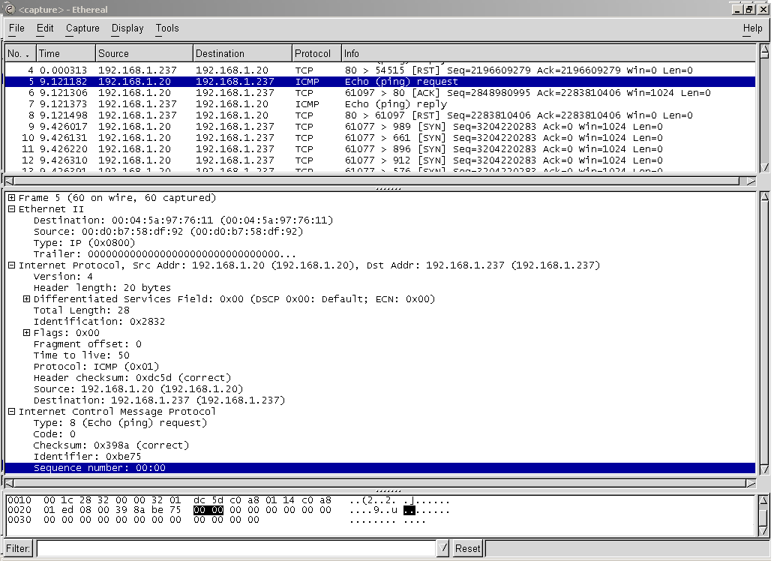

Slide 19
Related Tools for Network IDS (II)
Also not an element of Snort, tcpdump is a well-established CLI packet capture tool
  www.tcpdump.org offers UNIX source
  http://www.winpcap.org/windump/ offers windump, a Windows port of tcpdump

Slide 20
Case Study: Snort IDS

Slide 21
Backup Slides

Slide 22
Problems with Current IDSs
Inaccuracy for exploit based signatures
Cannot recognize unknown anomalies/intrusions
Cannot provide quality info for forensics or situational-aware analysis
  Hard to differentiate malicious events with unintentional anomalies
    Anomalies can be caused by network element faults, e.g., router misconfiguration, link failures, etc., or application (such as P2P) misconfiguration
  Cannot tell the situational-aware info: attack scope/target/strategy, attacker (botnet) size, etc.

Slide 23
Limitations of Exploit Based Signature
Signature: 10.*01
1010101
Internet
Traffic Filtering
10111101
X
Our network
X
11111100
00010111
Polymorphism!
Polymorphic worm might not have exact exploit based signature

Slide 24



Vulnerability Signature
Vulnerability
signature traffic filtering
Internet
X
X
Our network
X
X
Vulnerability
Work for polymorphic worms
Work for all the worms which target the
same vulnerability

Slide 25
Example of Vulnerability Signatures
At least 75% vulnerabilities are due to buffer overflow
Sample vulnerability signature
Field length corresponding to vulnerable buffer > certain threshold
Intrinsic to buffer overflow vulnerability and hard to evade
Overflow!
Protocol message
Vulnerable buffer

Slide 26
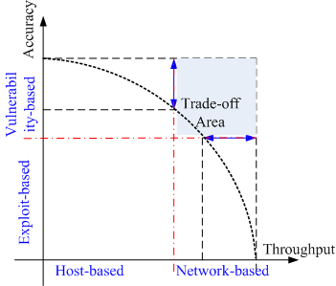
Next Generation IDSs
Vulnerability-based
Adaptive
  - Automatically detect & generate signatures for zero-day attacks
Scenario-based for forensics and being situational-aware
  Correlate (multiple sources of) audit data and attack information

Slide 27
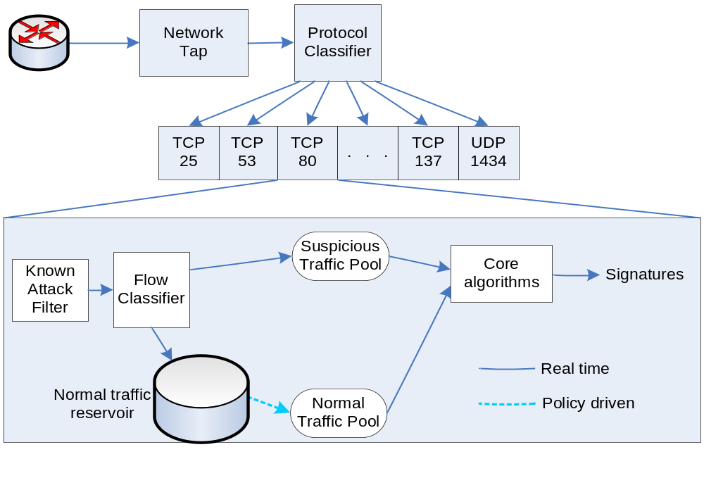
Counting Zero-Day Attacks
Honeynet/darknet, Statistical detection

Slide 28
Security Information Fusion
Internet Storm Center (aka, DShield) has the largest IDS log repository
Sensors covering over 500,000 IP addresses in over 50 countries
More w/ DShield slides

Slide 29
Requirements of Network IDS
High-speed, large volume monitoring
  No packet filter drops
Real-time notification
Mechanism separate from policy
Extensible
Broad detection coverage
Economy in resource usage
Resilience to stress
Resilience to attacks upon the IDS itself!

